Slide 1

SAP Datasphere Training – Day 2
www.anubhavtrainings.com

Slide 2
Agenda
User Persona
01
Understand default roles provided by SAP Datasphere.
Get started with Standard roles and Data Builder.
Datasphere Modelers
02
What does datasphere offers from modeler’s perspective.
www.anubhavtrainings.com
Data Builder
03
Getting know the different data objects by data builder in SAP Datasphere
Create Objects
04
Create DB tables and views in Datasphere and consume the same in SAP Analytics cloud

Slide 3
User persona in SAP Datasphere
System Owner – Includes all the privileges to allow unrestricted access to all the areas of the application. This will be assigned to exactly one user and must be assigned to someone.
DW Administrator – can create users and spaces and have full access across whole of system.
DW Space Administrator – Can manage all aspects of spaces which they are member of. They will manage space quotas, storage assignments and workload management properties. They assign which users can work with space. They also control the usage of content network.
DW Integrator – can create and edit connections and database users, and associated HDI container in space in which they are the members.
DW modeler – can create and edit objects inside data builder and business builder and view data in all objects in all spaces which they are member of.
DW Viewer – can view objects in spaces of which they are member and view data output by view that are exposed for consumption in these spaces.
DW Consumer – can consume data exposed by sap datasphere spaces of which they are member of using SAP Analytics cloud.

Slide 4
User persona in SAP Datasphere
Catalog Administrator – can setup and implement data governance using catalog. This includes connecting the catalog to source system for extracting metadata, building business glossaries, creating tags for classification, and publishing enriched catalog assets to all catalog users.
Catalog User – can search and discover data and analytical content in catalog for consumption. These user may be modelers who want to build additional content based on official, governance assets in the catalog.

Slide 5
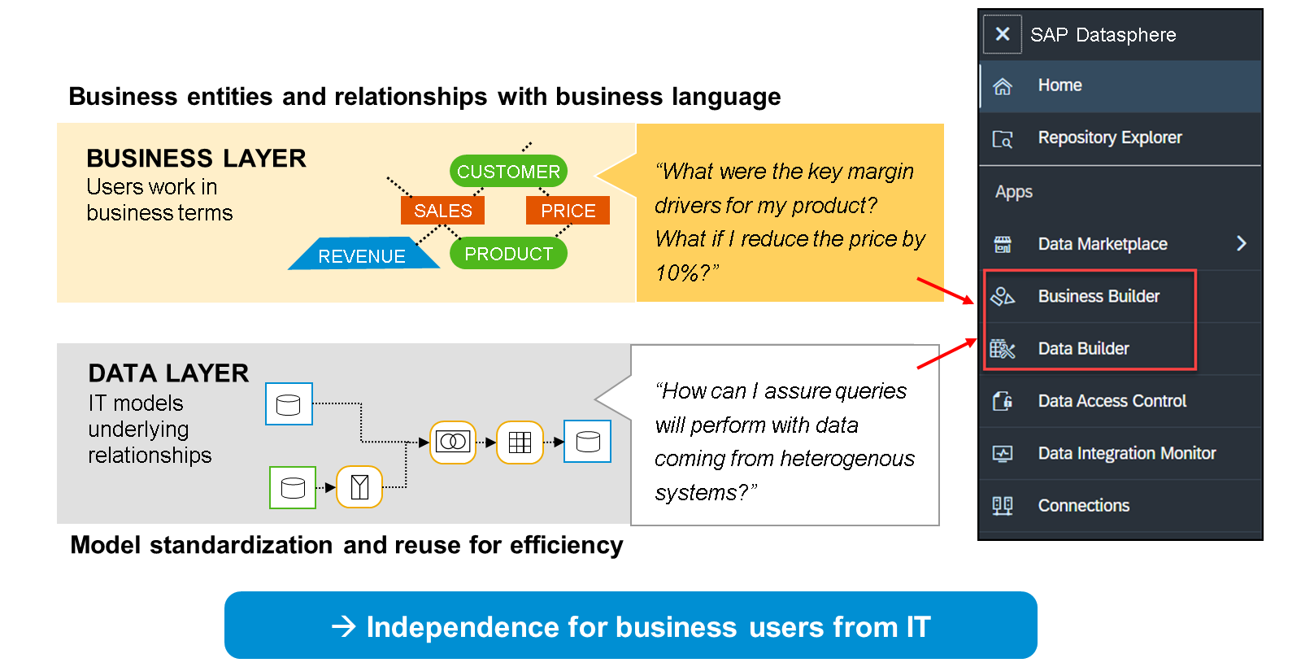
SAP Datasphere Modelers

Slide 6
SAP Datasphere Modelers
SAP Datasphere offers multiple modeling capabilities that addresses different user groups – from business analyst with deep business understanding to tech-savvy developers and power users. In a typical end to end scenario, two closely related components of datasphere are applied
Data layer – contains the basic modeling of underlaying data sources and tables. The related set of tools are available in data builder. Here developers and modelers use tables, views, and intelligent lookups to combine, clean and prepare data. Views are exposed sometime directly to analytic cloud.
Business layer – allows users to create their own business models on top of data layer in business terms. The related set of tools are provided in the business builder. Data builder objects like table, views are consumed in the business builder from consumer point of view to calculate KPIs, aggregate data, create final results for consumption tools. They combine, refine, enrich the data builder artefacts in more sematic approach. We can add semantic information before exposing lightweight, tightly focused objects for consumption by analytic cloud.

Slide 7
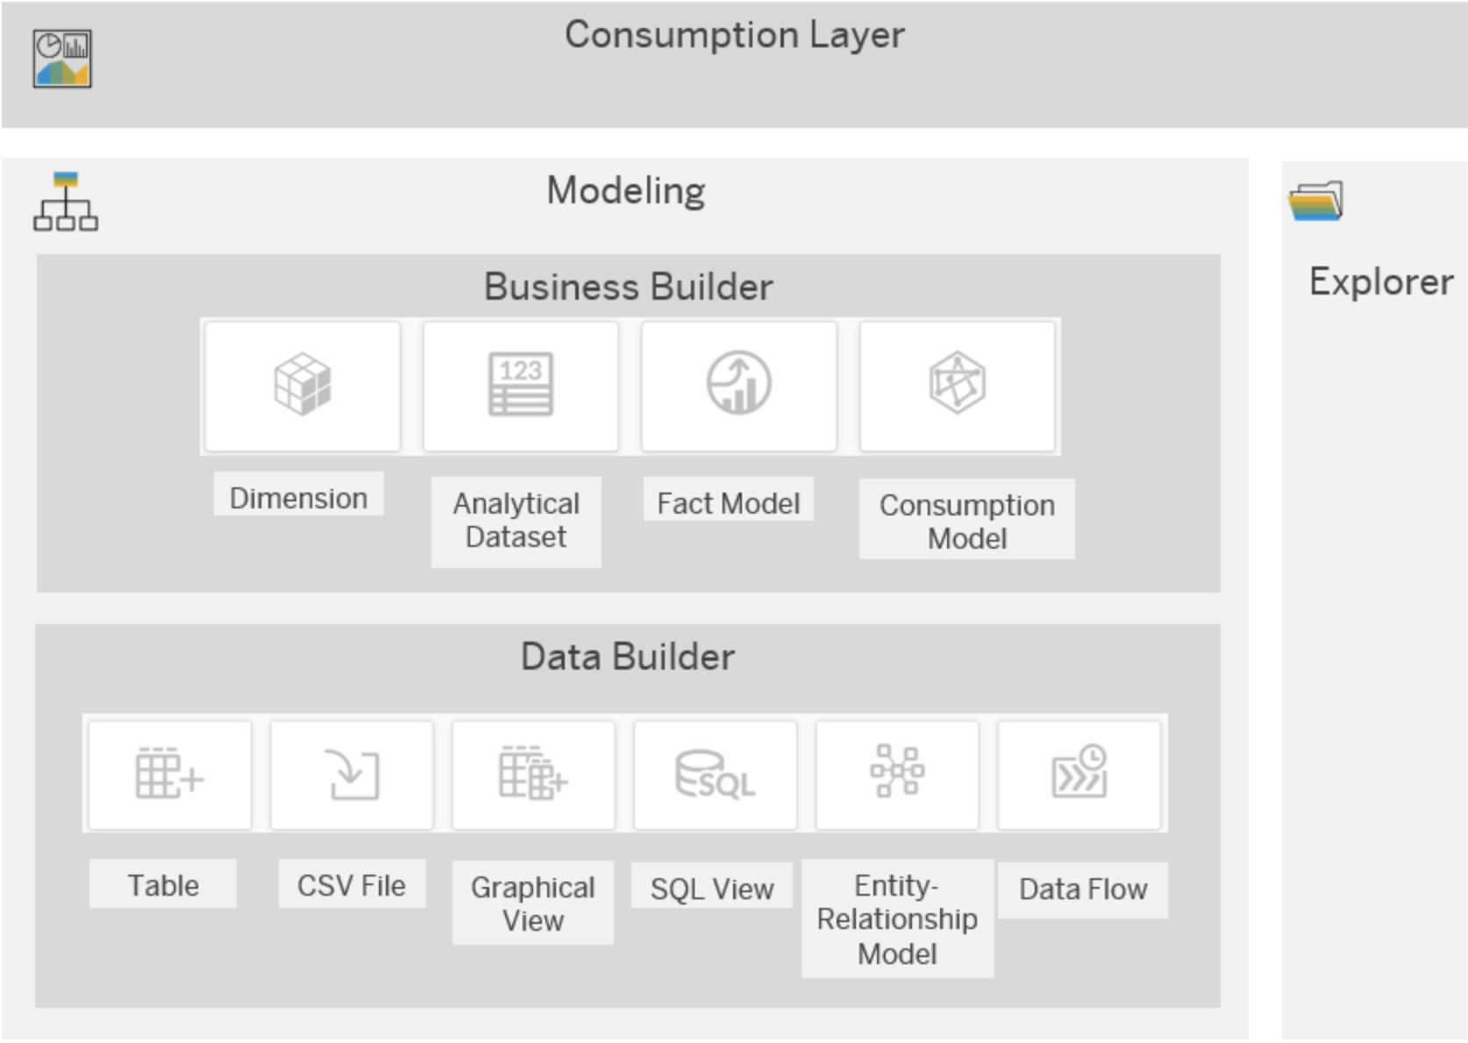
SAP Datasphere Builder Layers

Slide 8
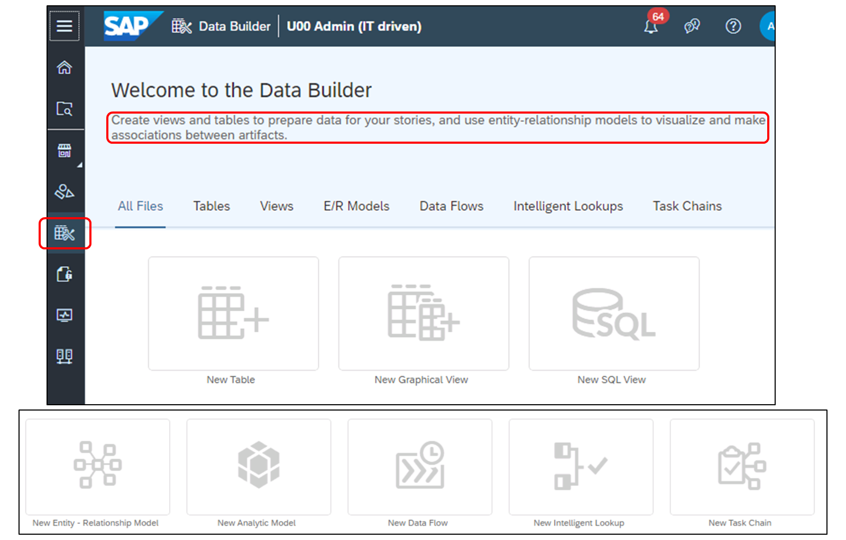
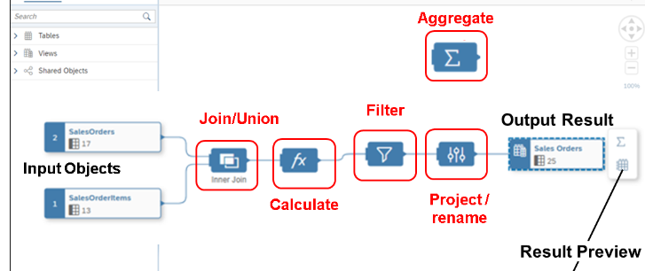
SAP Datasphere – Data Builder
Provides an editor to model data builder artifacts in an intuitive graphical interface. We can drag and drop data sources from source browser, join, select, filter, union on top of it. We can aggregate data, specify measure, add calculations, enrich geo, create currency conversions, add calculated columns.
Table Editor
Graphical View Editor
SQL view editor
Entity Relationship editor
Analytical model editor
Data flow editor
Intelligent lookup editor
Replication flow editor (ETL)
Task chain editor

Slide 9
SAP Datasphere – Data Builder
Table – two-dimension structure to store the data. Data is stored in row and column format, we can configure each field of the table, and define semantics and association.
Graphical view – we can leverage table and other views to prepare data and create views using a graphical low code/no code editor. Join datasets as appropriate, add other operators to remove or create columns and filter or aggregate data, add other operators to remove or create columns and filter or aggregate data. Finally we configure output node.
SQL view – Using SQL language we can create views also use SQL Script table function with powerful editor.
ER Model – here we define relationships between tables or views, which are being leveraged when you create a new view based on table.
Data flows – we define data flow to use data transformation and leverage the option to load data from different sources and persist it in SAP datasphere.
Intelligent lookup – create an intelligent lookup to merge data from two entities even they have problem joining them.
Task Chain – create task chain that group multiple tasks and run them manually or automated way with a schedule.

Slide 10
Understanding Dimension and Measure
Master data - Dimension
Master data - Dimension
CID | Name
A | SAP
B | IBM
C | Apple
PID | Name
P1 | Laptop
P2 | Smartphone
P3 | DVD Drive
Transactional data – facts
KPI – Key performance indicator – Measure
A measure is always numeric
SOID | CUSTID | PID | AMT | CTRY
1 | A | P1 | 500 | IN
2 | B | P2 | 800 | US
3 | A | P2 | 1500 | IN
3 | B | P1 | 2580 | US
4 | C | P3 | 8000 | CN
We apply aggregation – SUM, MIN, MAX, COUNT, AVG
TIME
Day, week, month, Q, H, Year
Master data - Dimension
CTRY | Country
IN | India
US | United States
CN | China

Slide 11
Semantic Usage and Types?
Relational – dataset contains columns with no specific analytic purpose.
Dimensions – pure master data, indicate that our entity contains attributes that are used to analyze and categorize measures defined in another entity, like product master data.
Facts/Analytical – dataset which indicates transaction data and contains one or more measure.
Hierarchies – it is actually master data but managed in a tree data structure / parent child relationship.
Texts – to indicate that our entity contains language column and language specific master data.

Slide 12
Hands on : Creating table using CSV upload
Upload data
Assigning semantic types
Define Primary keys, compound keys, default value, column visibility, associations, field names, data types, descriptions, semantics
Delete and upload new data
Preview and share table with other spaces
Allow to refresh metadata for the definition of a remote table
We would like to build an analytic dashboard for our store application.

Slide 13
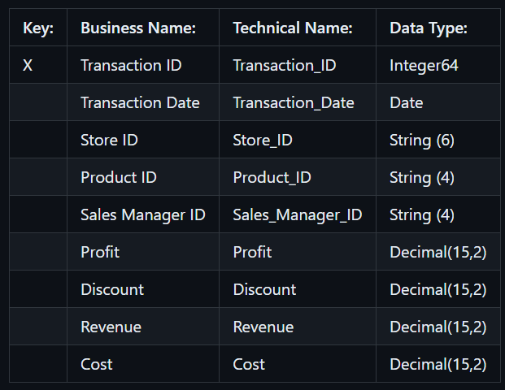
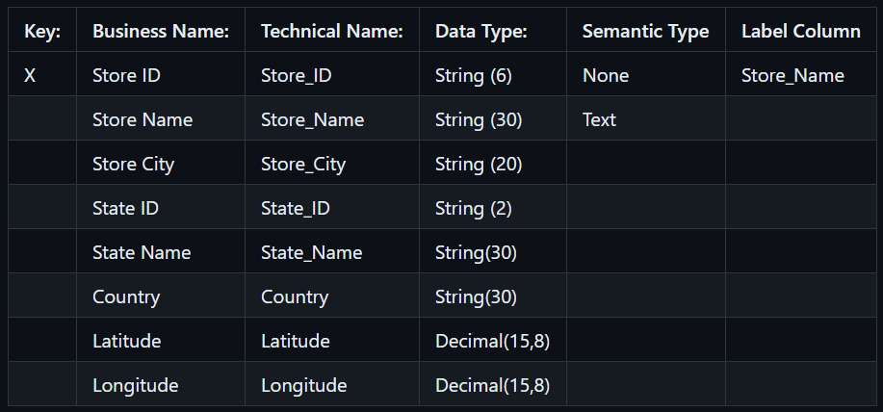
Creating Tables using “New Table”
Business Name - Sales Transactions
Technical Name - Sales_Transactions
Type - Relational Dataset
Business Name - Store
Technical Name - Store
Type - Dimension

Slide 14
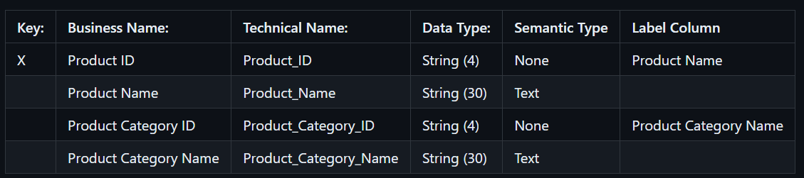
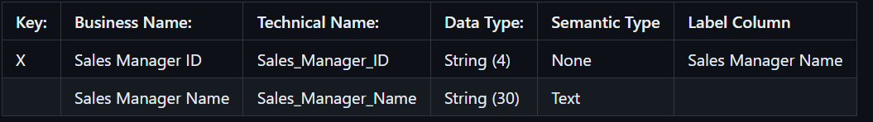
Creating Tables using “New Table”
Business Name - Product
Technical Name - Product
Type - Dimension
Business Name - Sales Manager
Technical Name - Sales_Manager
Type - Dimension

Slide 15
Time & Generate Time Data
Time is a dimension which represents day, week, month, Q, H, Y
We can enrich our models and stories with time dimension
By Default time is treated by system as a hierarchy
We can create time dimension data at space level, system will automatically create the time tables known as M* Tables
We can decide how many years of data we want to generate
time table(S) are created once per space

Slide 16
What is Entity Relationship Model
An entity relationship model provides variety of benefits:
Definition of entity and their associations with other entities from business standpoint
Design physical or remote data model
Reuse existing (tables/views) from data builder
Add new entities on fly
In editor real time data preview
Model import/export

Slide 17
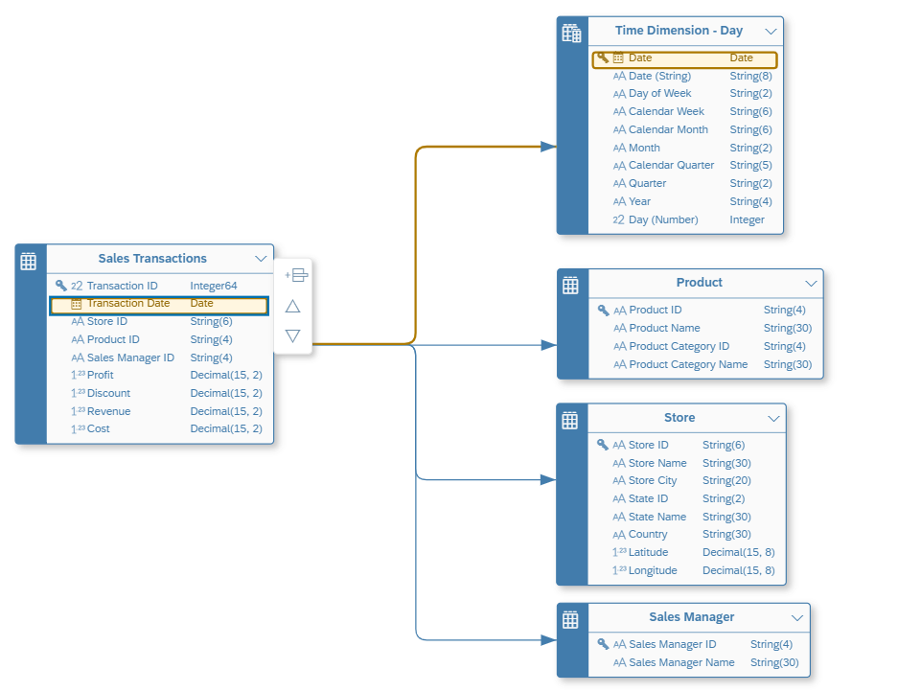
Store ER Diagram

Slide 18
Hands-on Uploading ER diagram as JSON
Exercise
You can upload the json file provided in data kit to create your ER Model.

Slide 19
Views in Datasphere
A view in sap datasphere provides several benefits:
Graphical or script based
Define view on top of remote, replicated data sources or tables
Define joins and unions, rename and remove columns, add calculations and filter
Enrich your data with geo coordinates and apply currency conversions
Create Dimension, fact or relational data models
Create parent child or level-based hierarchies in dimension views
Define measures and attributes in fact views

Slide 20
View Editor
View on top of remote, replicated or local tables
Define measure and attributes for fact data views
Create multi language text fields
Define join types, joins, associations, aggregations, unions
Rename columns for reporting purpose
Add filters to discard unnecessary data hence improve reporting performance
We can project columns and also reduce volume of data transfers
Apply access control, input parameters, view persistency
View data at each node

Slide 21
Association
An association is a relationship between entity and other entities/views. But it is very different from a join. A join when added, is bound to perform. There is no way we can avoid database to not carry out join. Since database has to mandatorily do the join, it takes time.
Association is a lose coupling, when we read data from the view, the data will be fetched from main table. When we use association, only them the join will be carried out at runtime.

Slide 22
Data Layer: Introduction to Analytical Model
The Analytical model is one of the cornerstone of SAP datasphere in that it allows multi-dimensional modeling and semantically rich data modeling to answer business questions easier, faster and more efficiently. The Analytical model elevates the rich data & semantics of SAP datasphere for immediate consumption in SAP Analytics Cloud. Broadly it provides following benefits
Rich measure modeling
Careful design how analytics users see the data
Collection of user input via prompts in SAC
Rich preview capabilities
Time Dependency support
Dependency Management and transport
Notes:
Create analytical model on Sales order view
Expose same to SAP Analytics Cloud
Create analytical model on Store view
Add calculated measure, restricted measure, Aggregated measure
Consume in SAC with Geo Map

Slide 23
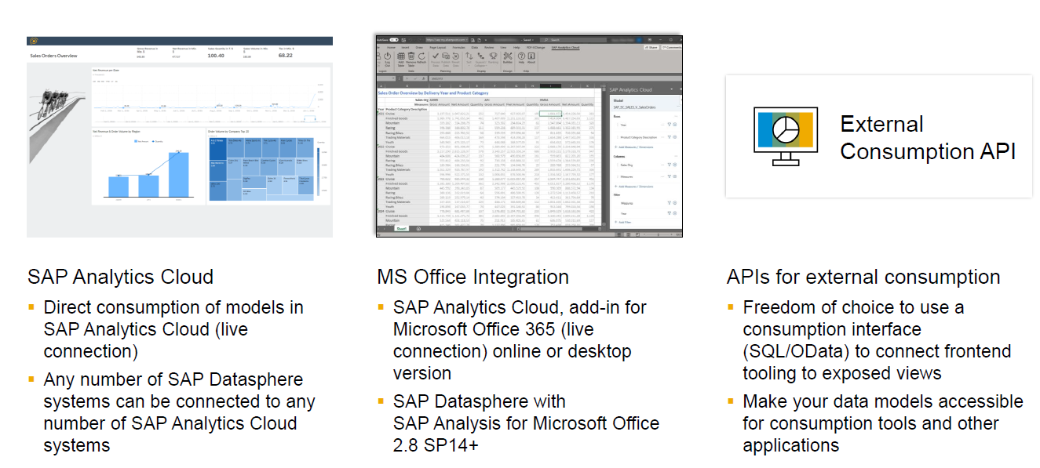
Options for analytic consumption and openness with external tooling

Slide 24
SAP Datasphere Connection Overview
Connections provide access to data from wide range of sources : cloud and on-premise, SAP or Non-SAP Sources and partner tools.
We can only spaces we are a member of space overview (connections are space specific)
Create, edit, delete and validate location connections
Pause and restart connection with real time replications
Integrate open connectors and also connect to third party data sources.

Slide 25
Connection Types
Each connection type supports a defined set of features, depending on the connection type and the connection configuration, a connection can be used for one or more of following features
Remote Table – Allows modelers to import table from a source when creating graphical and SQL views or entity relationship model. During the import, the tables are deployed as remote table. Depending on connection type, you can use remote tables to:
Directly access data from the source (Remote access)
Copy the full data set from source system (Snapshot or scheduled replication)
Copy data changes in real time (Real time replication)
Model Import – Allows modelers to import objects from any supporting SAP system with rich metadata and, if supported, with their dependencies. This way, we can leverage our existing investment from customer landscape without rebuilding the objects manually.
Data Flows – Allows modelers to use objects from connected sources when creating data flows to extract, transform and Load (ETL). One example is to load the currency tables data.
Replication Flows – Allows modelers to replicate data from multiple source objects from a connected source to target including simple projections and mapping capabilities.
https://help.sap.com/docs/SAP_DATASPHERE/be5967d099974c69b77f4549425ca4c0/eb85e157ab654152bd68a8714036e463.html?locale=en-US

Slide 26
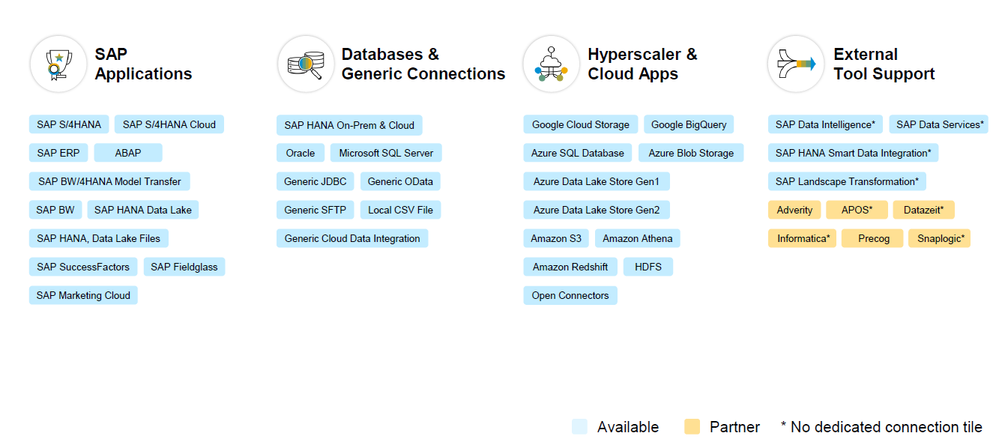
Connectivity Options

Slide 27

What We Did
Let’s Summarize

Slide 28

www.anubhavtrainings.com
Thank You
End of Day 2

Slide 29


We’re committed to empower you to be
#FutureReady
through powerful training solutions.
We build the workforce of the future.
250+
Corporate Clients
30,000+
Learners Trained
25000+
Learners Placed
FREE WEBINARS
Sign up for free webinars with industry experts every fortnight!
Enroll Now!
Contact us today!
https://anubhavtrainings.com

